Slide 1
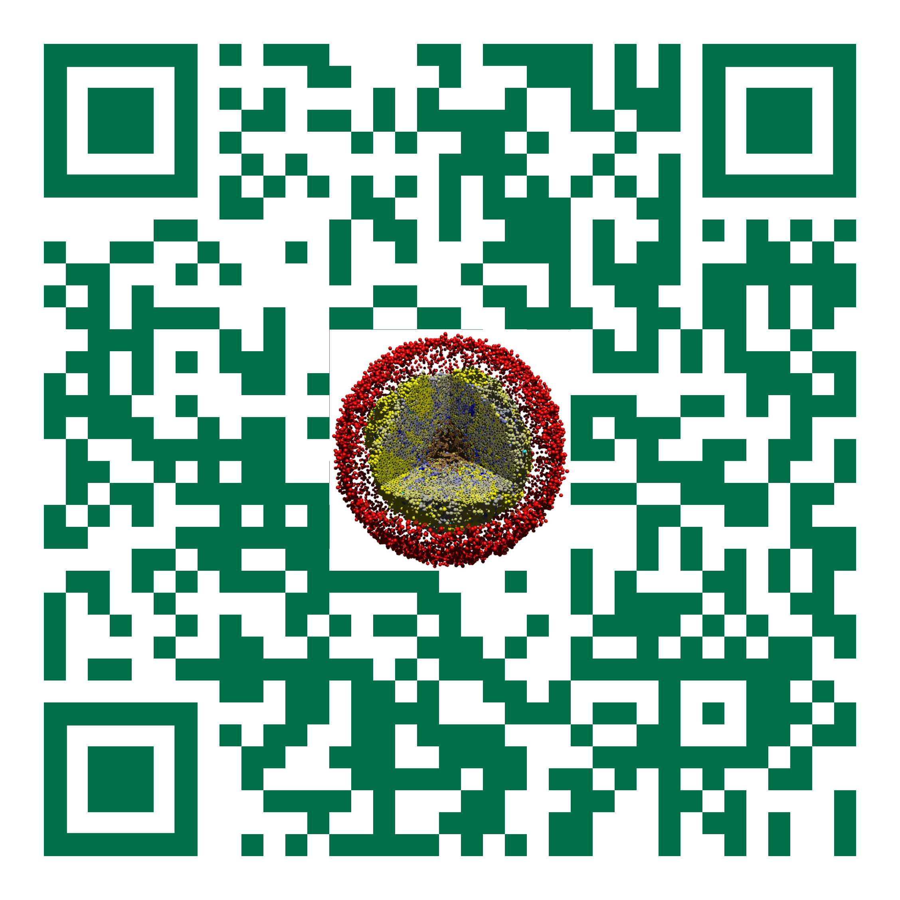
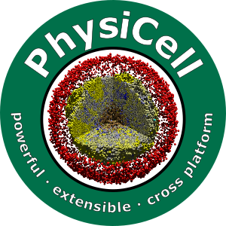

Setting up PhysiCell on Windows
Slides, videos, links and more:
https://github.com/physicell-training/ws2021
Furkan Kurtoglu & Aneequa Sundus
@PhysiCell
July 25, 2021

Slide 2
Thank you very much for watching!

Slide 3
Overview
This installation guide is prepared for installing PhysiCell to new fresh Windows. If you install PhysiCell 1.8.0 or previous version in your PC. Please uninstall MSYS and remove related directories from environmental variables.
PhysiCell
MSYS 2
Adding them to path
Anaconda
Test modules “biorobots” and “ode-energy-sample”
ImageMagick
COPASI
PhysiCell Model Builder
Minimal setup
Traditional* setup
*Traditional setup includes optional tools that helps for pre-simulation edits and pro-simulation analysis

Slide 4
Youtube video
Here is the video link for the recording of installation on Windows.
LINK HERE!!!!!!!!!!

Slide 5
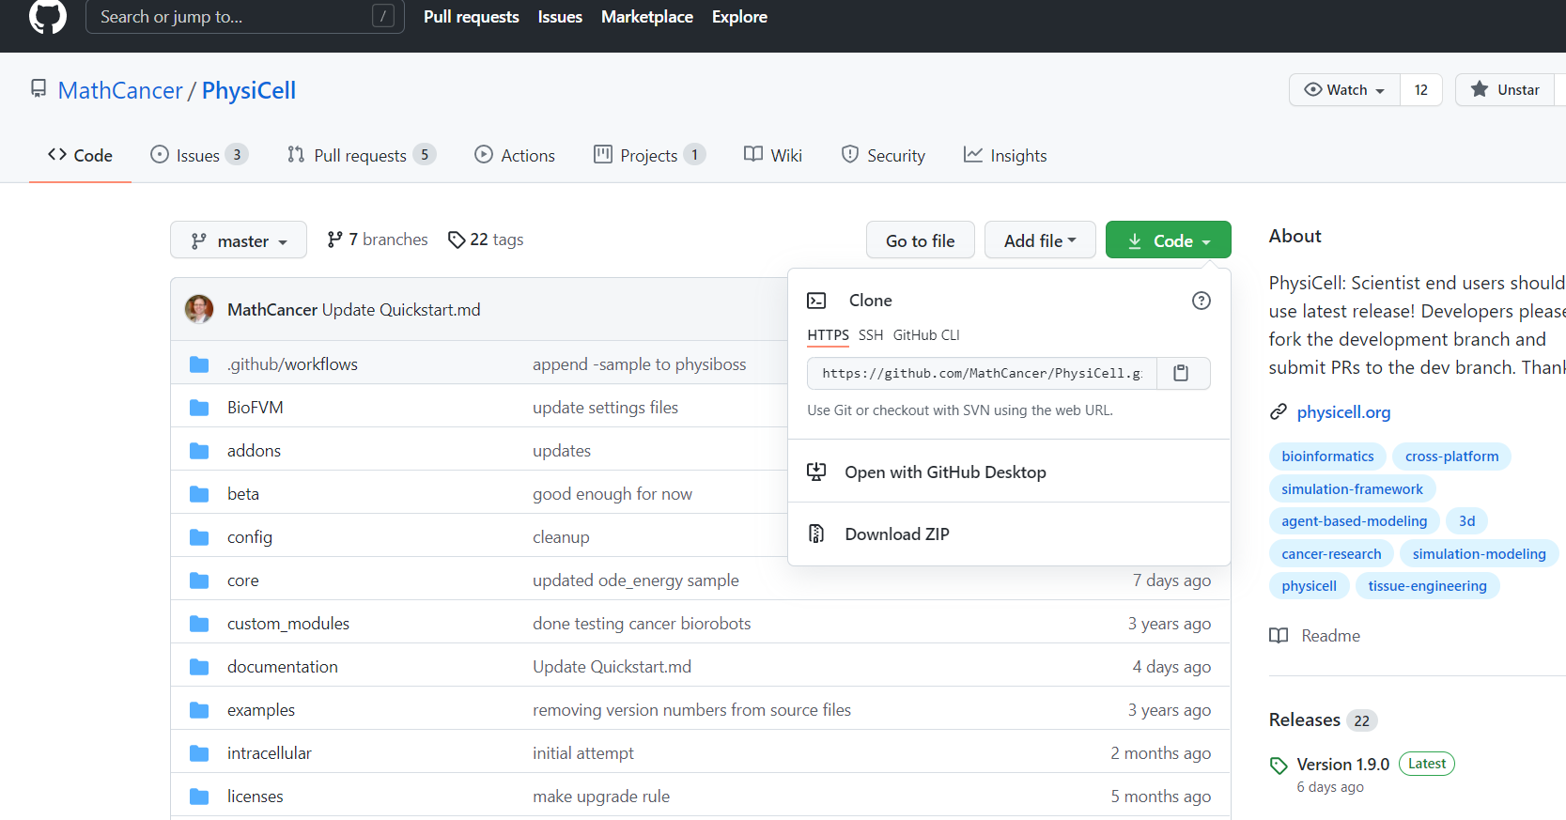
PhysiCell
To download PhysiCell please proceed following link: https://github.com/MathCancer/PhysiCell
Please, click green “Code” button at right.
Then, download as “ZIP”.
Extract to the desired directory.

Slide 6
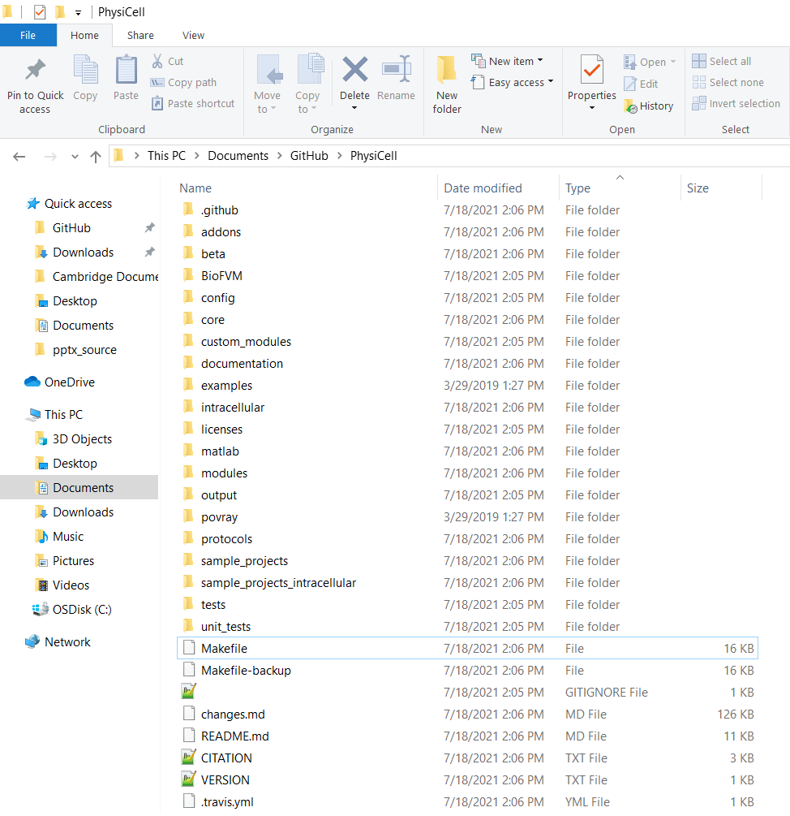
PhysiCell
After the extraction, PhysiCell folder should look like this:

Slide 7
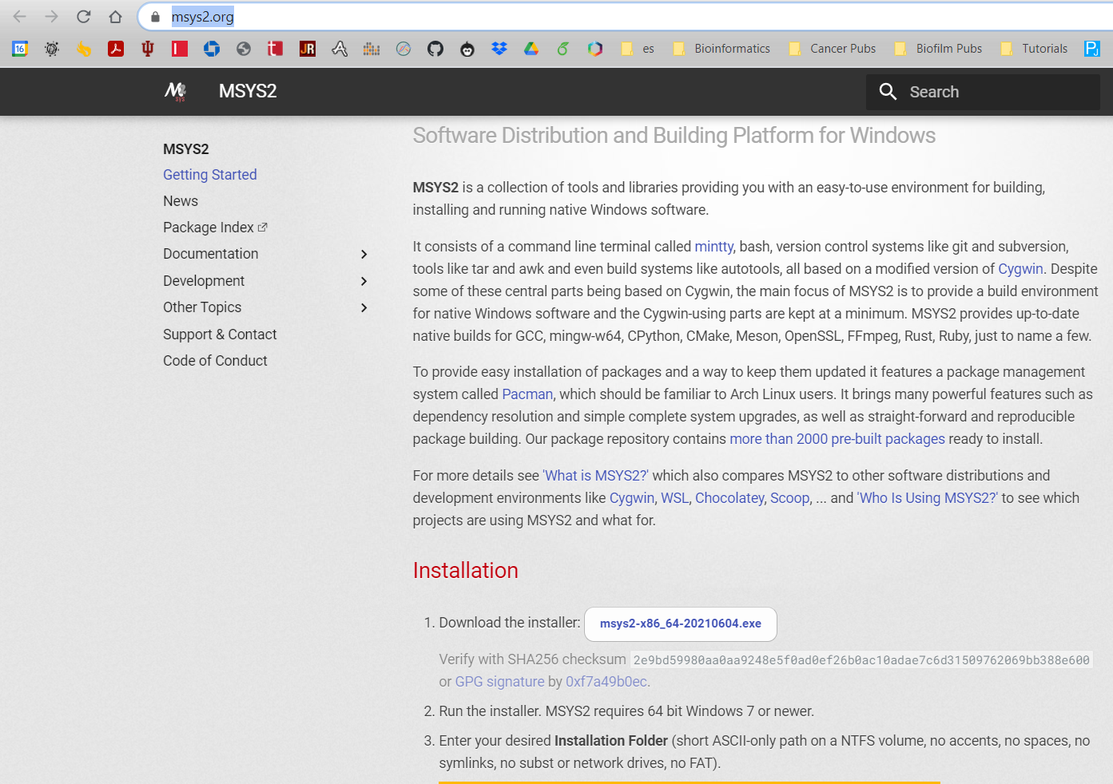
MSYS 2
Please proceed following link: https://www.msys2.org/
Please, click “msys-x64_64-202XXX.exe” button at bottom.
It should download installer.
Open it with double-clicking the installer.

Slide 8
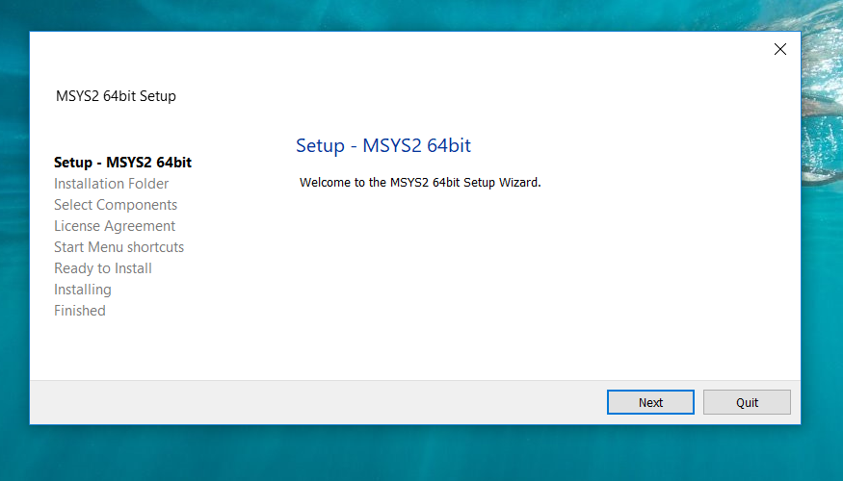
MSYS 2

Slide 9
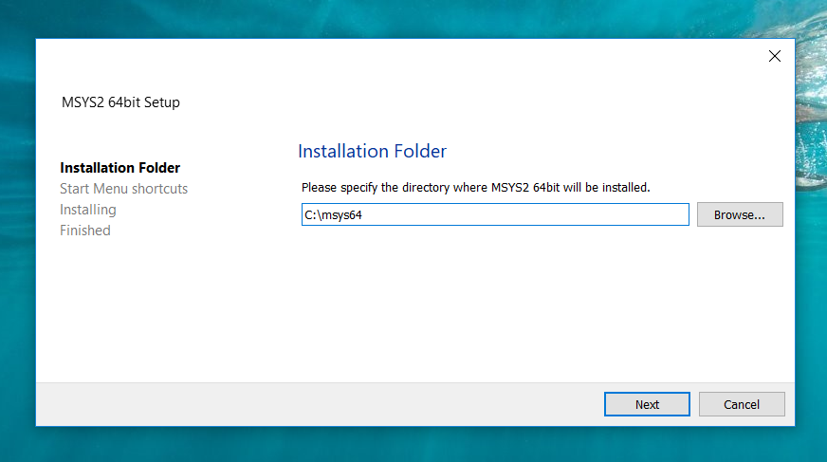
MSYS 2

Slide 10
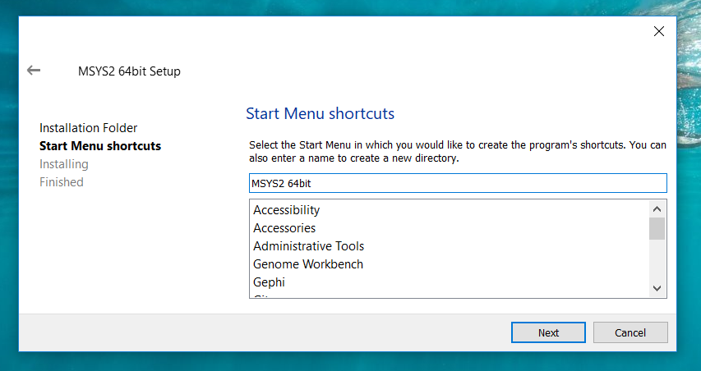
MSYS 2

Slide 11
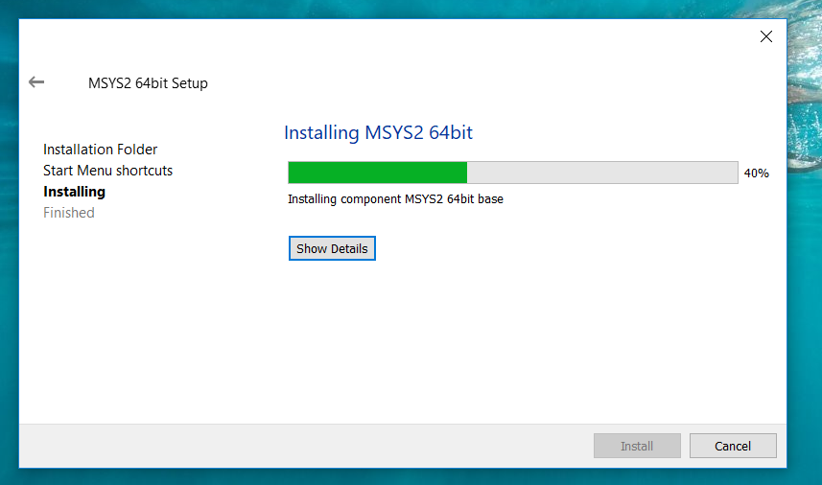
MSYS 2
Wait installation…

Slide 12
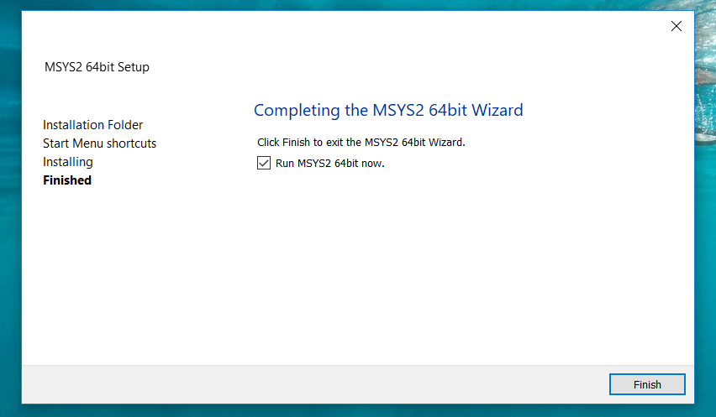
MSYS 2
Wait installation…

Slide 13
MSYS 2
After MSYS2 command prompt is opened, please copy and paste following line. Then, press enter.
pacman -S mingw-w64-x86_64-binutils mingw-w64-x86_64-gcc mingw-w64-x86_64-headers-git mingw-w64-x86_64-gcc-libs mingw-w64-x86_64-libwinpthread-git mingw-w64-x86_64-winpthreads-git mingw-w64-x86_64-lapack mingw-w64-x86_64-openblas mingw-w64-x86_64-libxml2 mingw-w64-x86_64-bzip2 git make

Slide 14
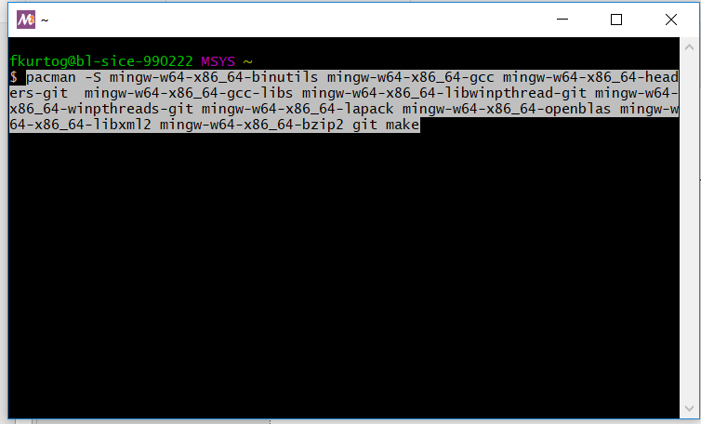
MSYS 2

Slide 15
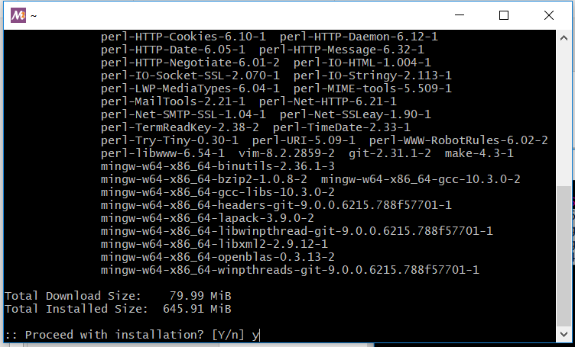
MSYS 2
Give “y” (yes) answer to the msys2. Press enter…

Slide 16
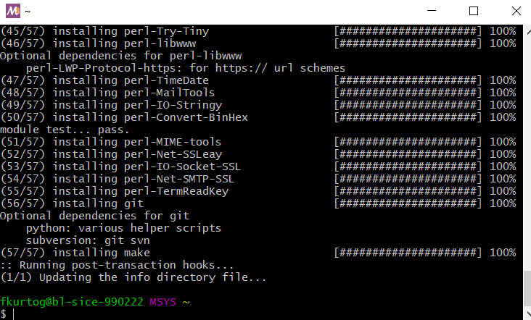
MSYS 2
It will take some time to install all required libraries. But in the end, you should not see any errors.

Slide 17
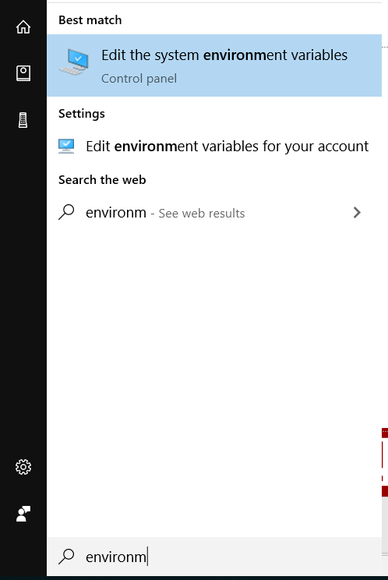
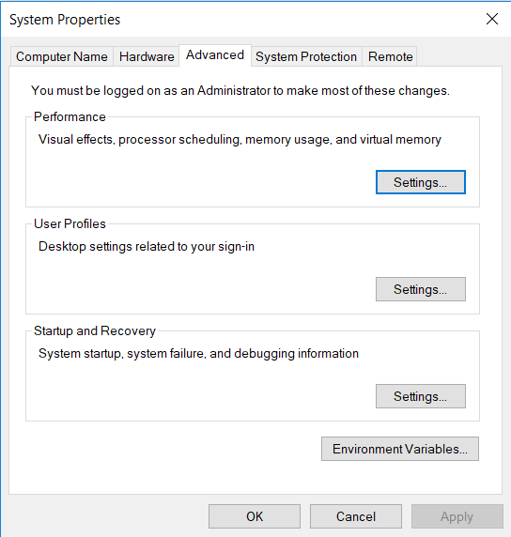
Adding directories to PATH
Please go to environmental variables with searching on Windows Start Menu.

Slide 18
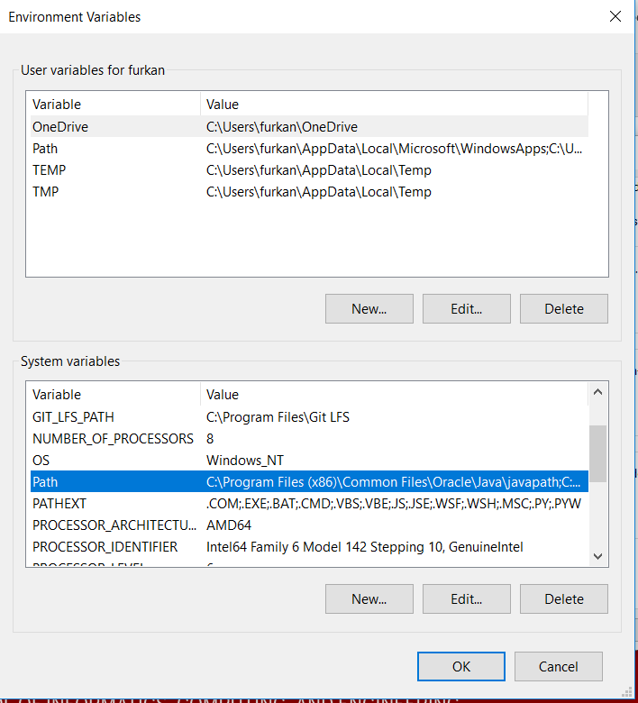
Adding directories to PATH
Please select to SYSTEM PATH and press “Edit…”

Slide 19
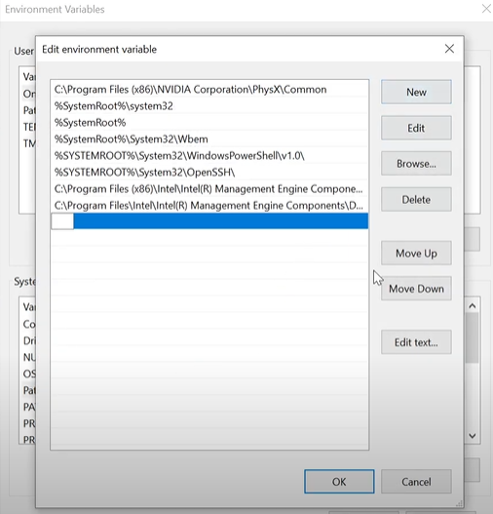
Adding directories to PATH
Please press “New”. And add following paths to there:
C:\msys64\mingw64\bin
C:\msys64\usr\bin
.\addons\libRoadrunner\roadrunner\bin

Slide 20
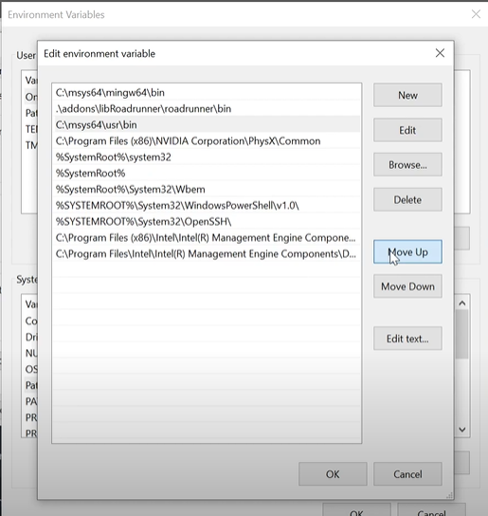
Adding directories to PATH
Then please “MOVE UP”, newly added three paths.
The list should like the following image.

Slide 21
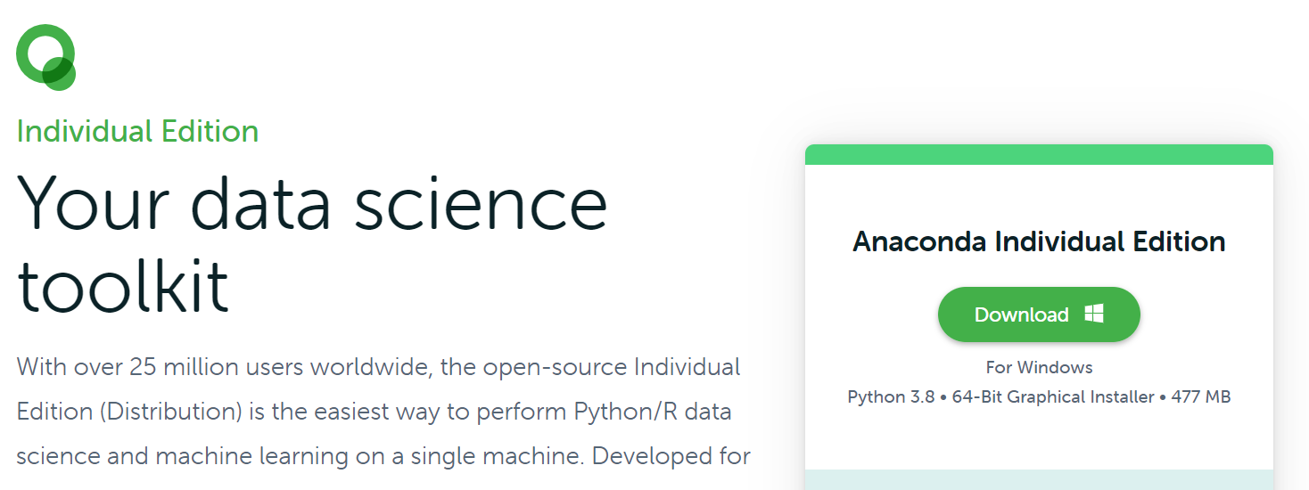
Anaconda
Please proceed following link: https://www.anaconda.com/products/individual

Slide 22
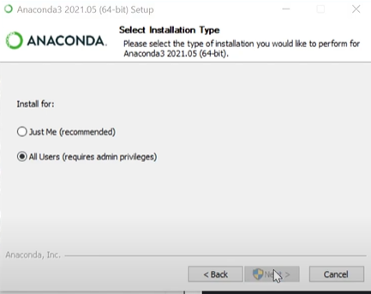
Anaconda
Please install for all users. (This is step is required for msys2 path priorities)
If you cannot install for all users. Please add msys2 paths for current user in the environmental variables. (Instead of systems variables, please use upper user variables)

Slide 23
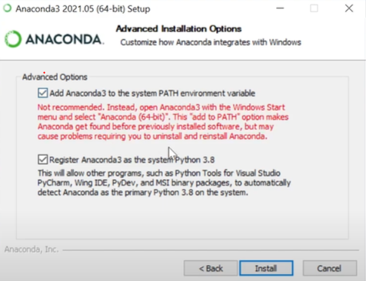
Anaconda
Please select option for adding Anaconda to the path.

Slide 24
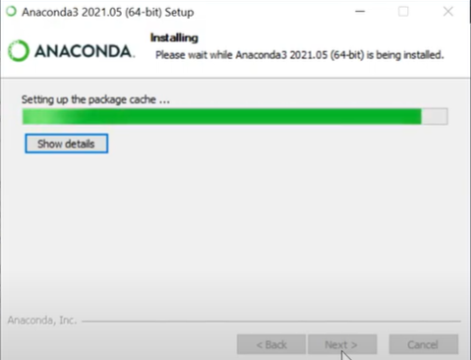
Anaconda
Installation…

Slide 25
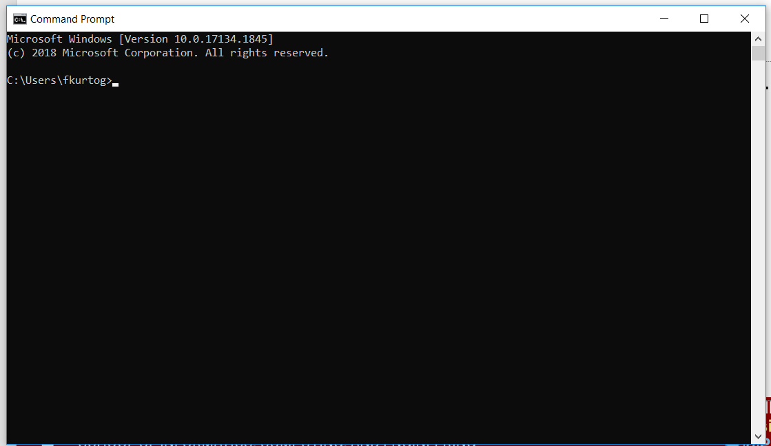
Test Module : “biorobots”
At this moment PhysiCell is ready to work. Let’s try “biorobots”, first.
Open command prompt from Start menu with typing “cmd”.

Slide 26
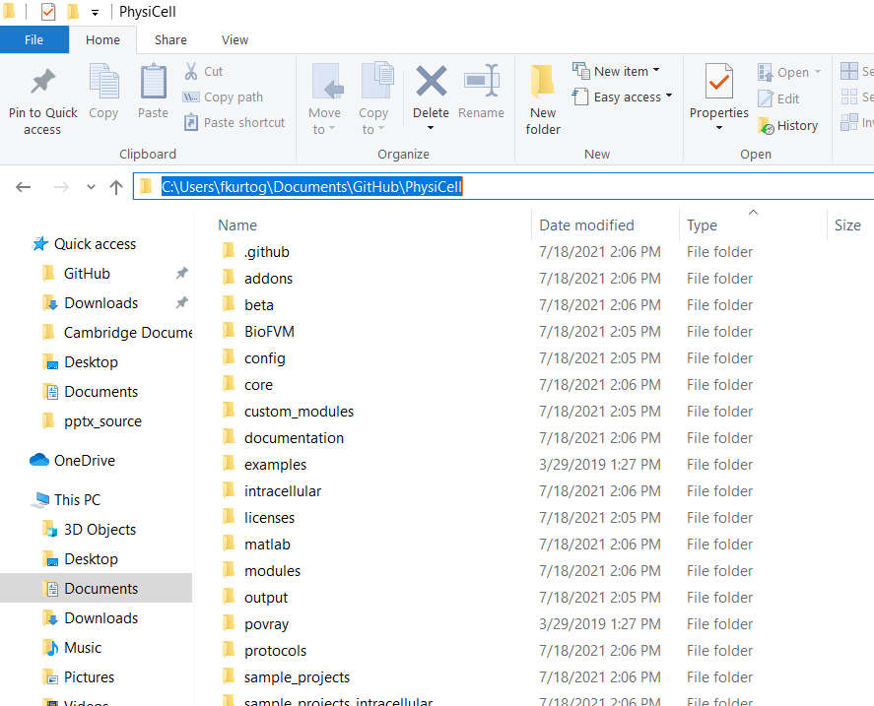
Going to PhysiCell folder
Proceed to the PhysiCell folder at File Browser.
Click to the directory address from top.
Copy it

Slide 27
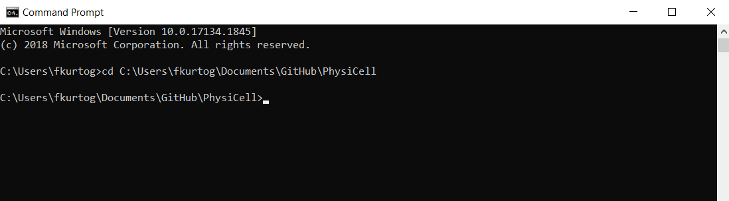
Going to PhysiCell folder
Type “cd” and paste the copied directory with space between them.

Slide 28
Testing Modules (biorobots)
Let’s compile “biorobots” sample project first.
Please run following commands in the command prompt.
make biorobots-sample
make
This should successfully compiles biorobots sample project that ready to run with following command.
./biorobots.exe

Slide 29
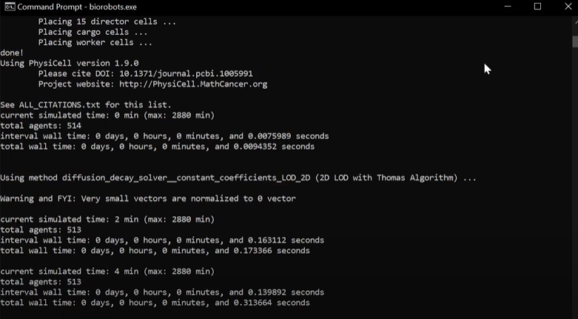
First simulation…

Slide 30
Testing Modules (ode-energy-sample)
If the first test is successfully created .mat and .xml files in the output folder. Let’s try “ode-sample” sample project. To do that:
make ode-energy-sample
make
While compilation, you should see “libroadrunner” installation. After the compilation, please use following command to run simulation.
./ode_energy.exe

Slide 31
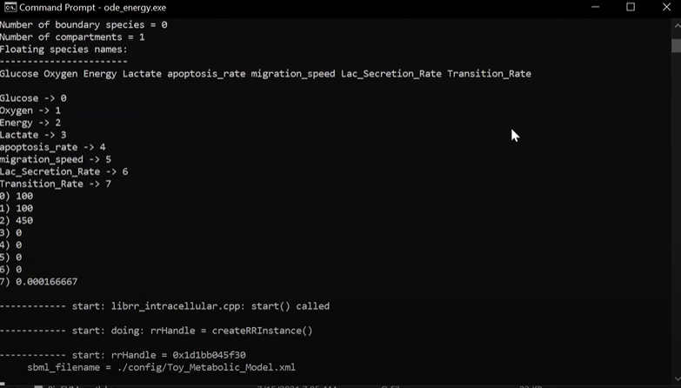
Second simulation… (ode-energy-sample)

Slide 32
Overview
We have finished the minimal setup. Following slides will show traditional setup.
PhysiCell
MSYS 2
Adding them to path
Anaconda
Test modules “biorobots” and “ode-energy-sample”
ImageMagick
COPASI
PhysiCell Model Builder
Minimal setup
Traditional* setup
*Traditional setup includes optional tools that helps for pre-simulation edits and pro-simulation analysis

Slide 33
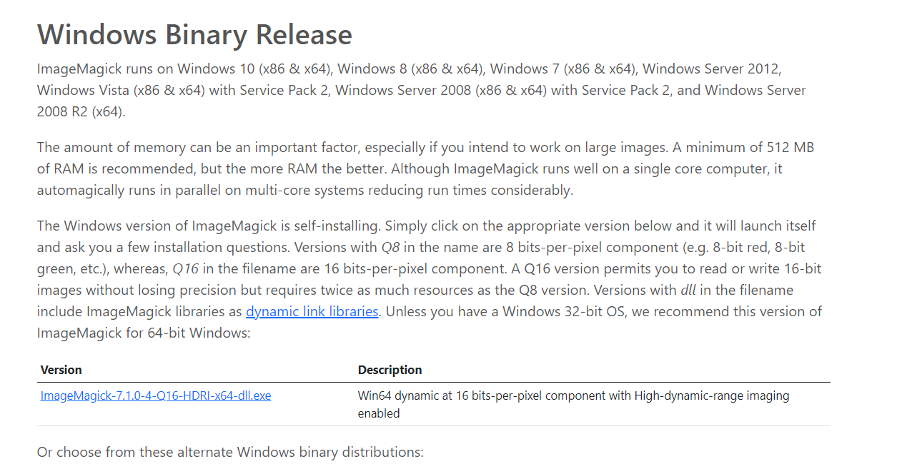
ImageMagick
Please proceed the following link: https://imagemagick.org/script/download.php
And go below for “Windows Binary Release” and click there to download.

Slide 34
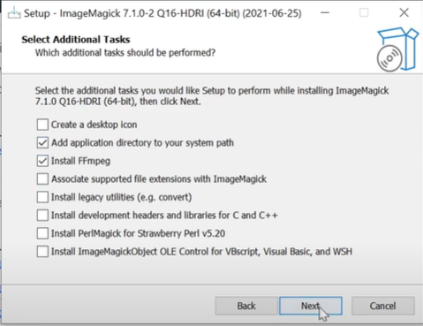
ImageMagick
Please be sure the option for adding directory to path is selected.

Slide 35
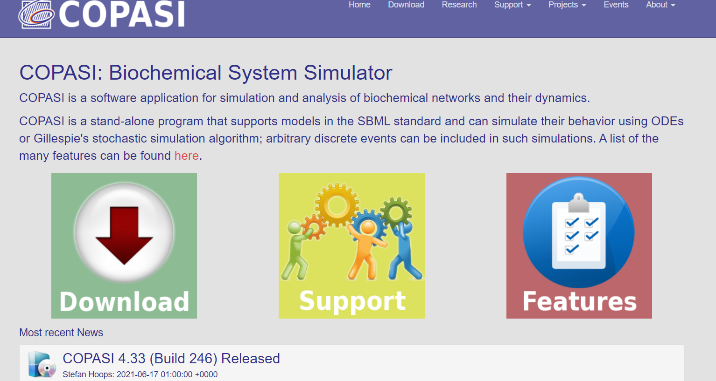
COPASI
Please proceed following link to download COPASI
http://copasi.org/
Install regularly

Slide 36
PhysiCell Model Builder (1)
The Model Builder is a GUI to let you create/edit a .xml configuration file that defines (nearly all of) a PhysiCell model.
Download the latest release at:
https://github.com/PhysiCell-Tools/PhysiCell-model-builder/releases
Uncompress the .zip, change directory into it, and run it:
This should display the GUI (next page):
$ unzip PhysiCell-model-builder-1.1.zip
$ cd PhysiCell-model-builder-1.1
$ python bin/gui4xml.py
Note that if your setup automatically unzips files after downloading, this command will not work. INSTEAD, skip the unzip command and go directly to the second command

Slide 37
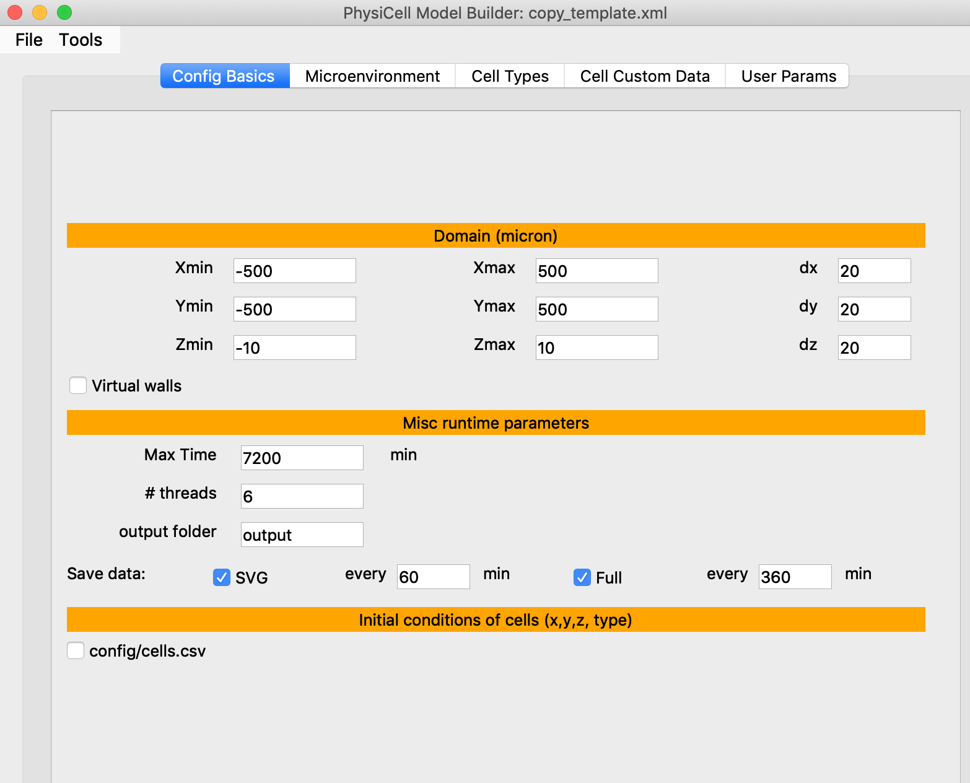
PhysiCell Model Builder (2)
A User Guide for the Model Builder is still be written.
It is a tool that is still considered “beta”, so your feedback will be very valuable.

Slide 38




Funding Acknowledgements
PhysiCell Development:
Breast Cancer Research Foundation
Jayne Koskinas Ted Giovanis Foundation for Health and Policy
National Cancer Institute (U01CA232137)
National Science Foundation (1720625)
Training Materials:
Administrative supplement to NCI U01CA232137 (Year 2)

